Slide 1


Slide 2


GROWTH & OPPORTUNITIES
November 5, 2025

Slide 3

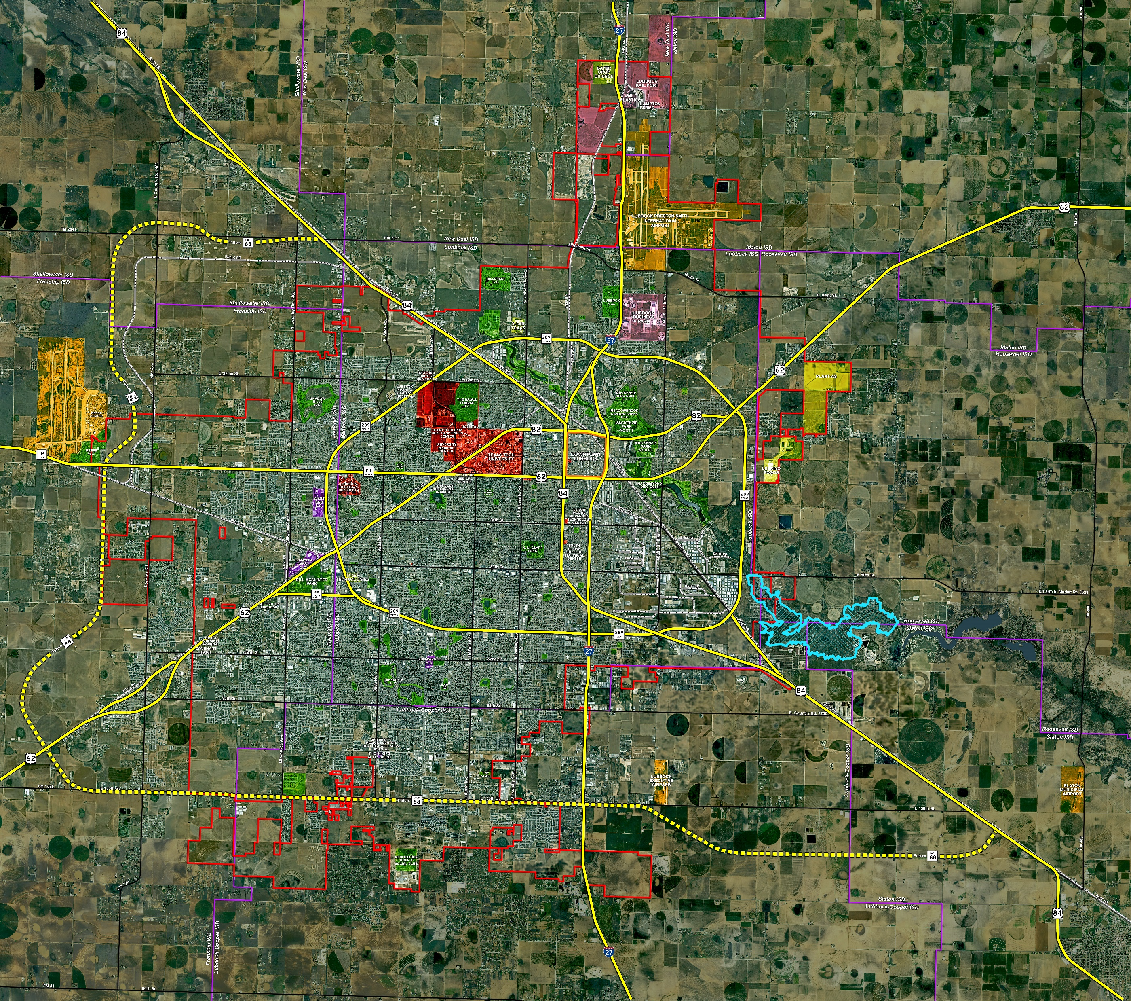

Growing Lubbock
2025
City of Lubbock: 276,180
Lubbock County: 332,430
Texas: 31,245,372
2025-2050
Population Growth
Lubbock Co 19.3%
Texas
28.2%

Slide 4



Population Patterns

Slide 5

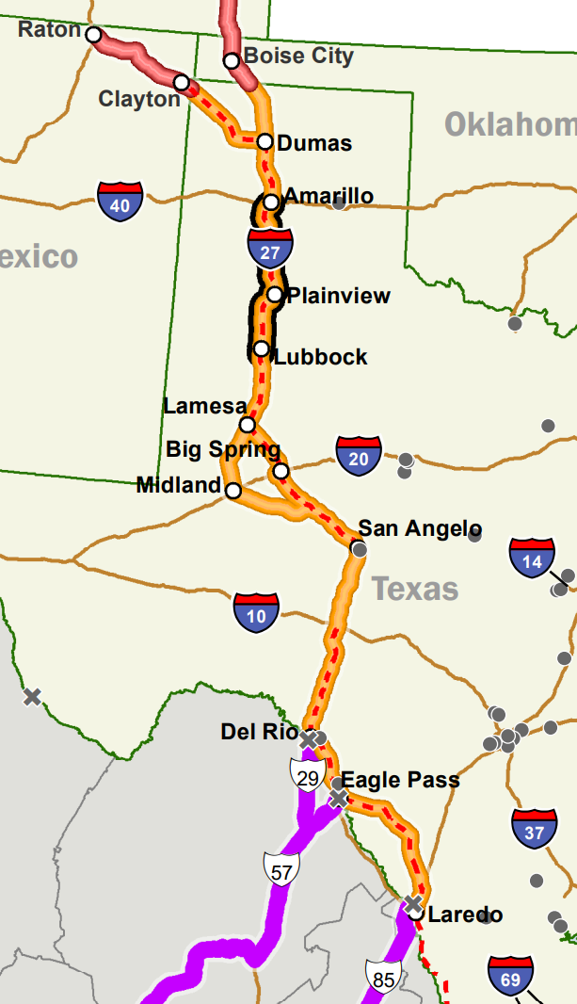

I27 & Hwy Growth

Slide 6
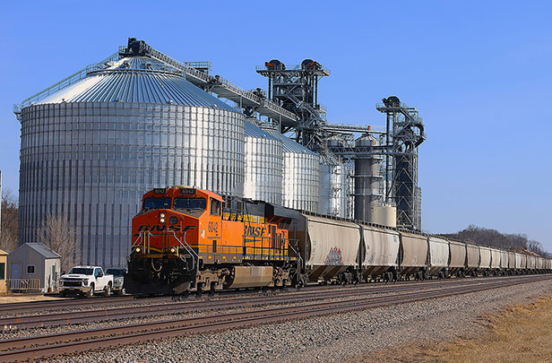




Rail Opportunities

Slide 7
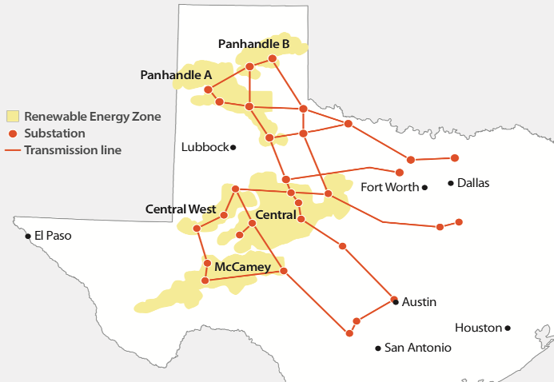

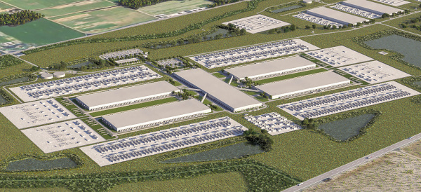
Providing Power
56% of Exports

Slide 8
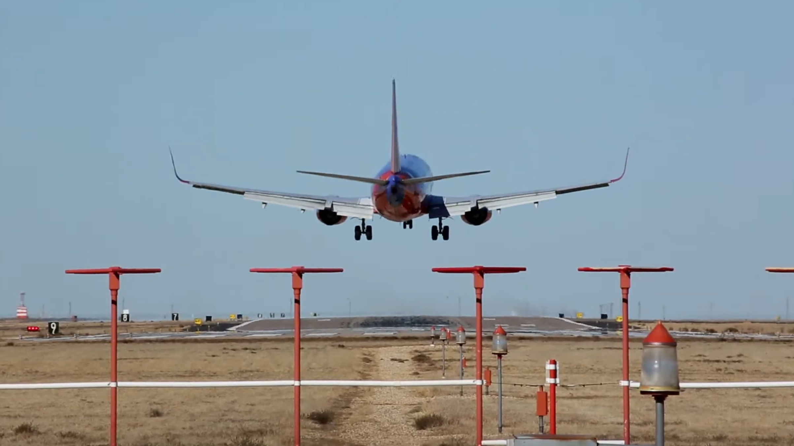

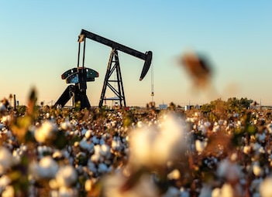
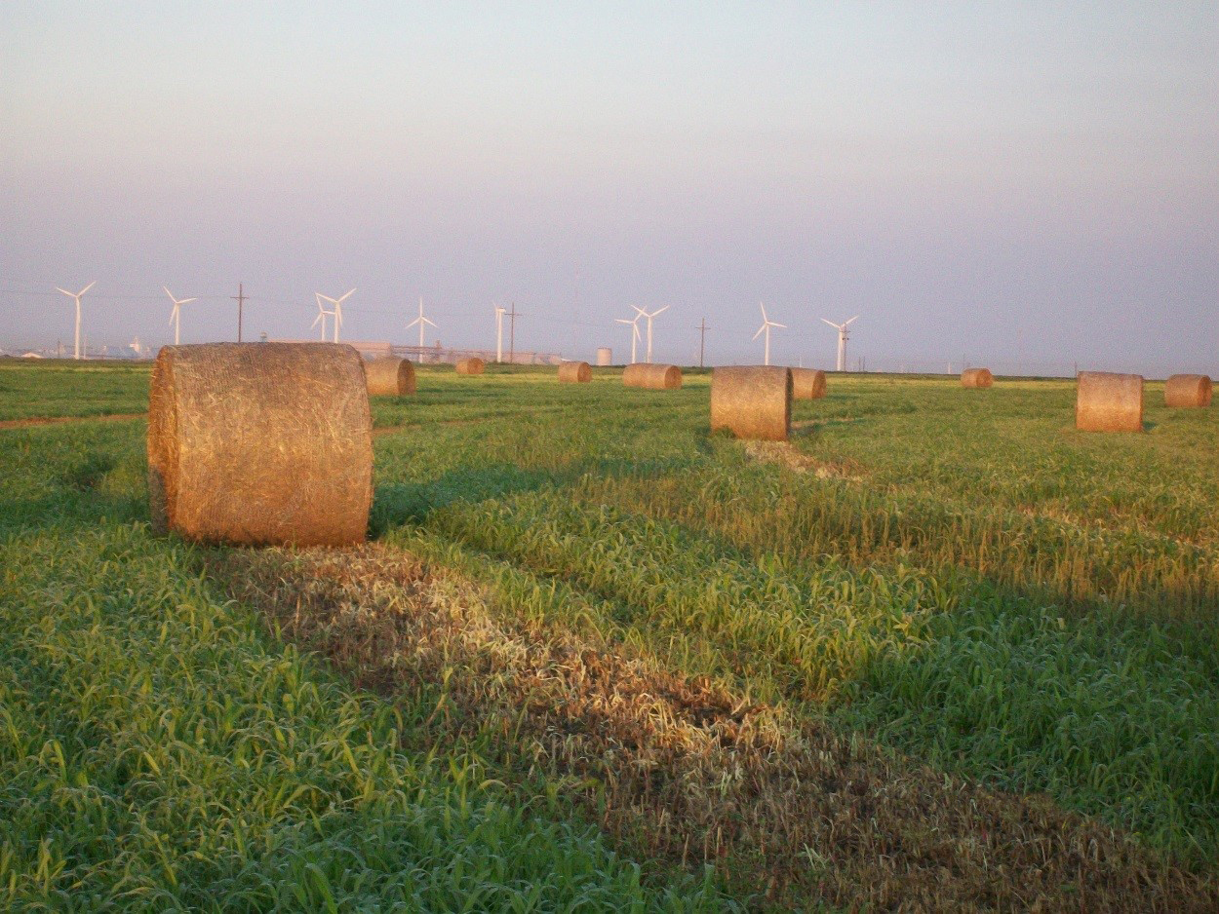

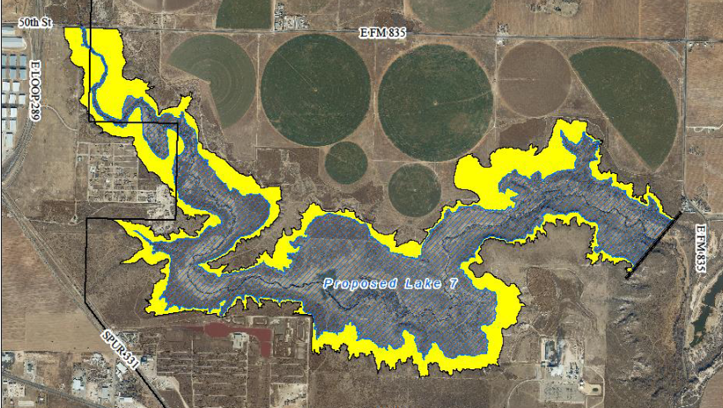
Development Awareness

Slide 9







Slide 10


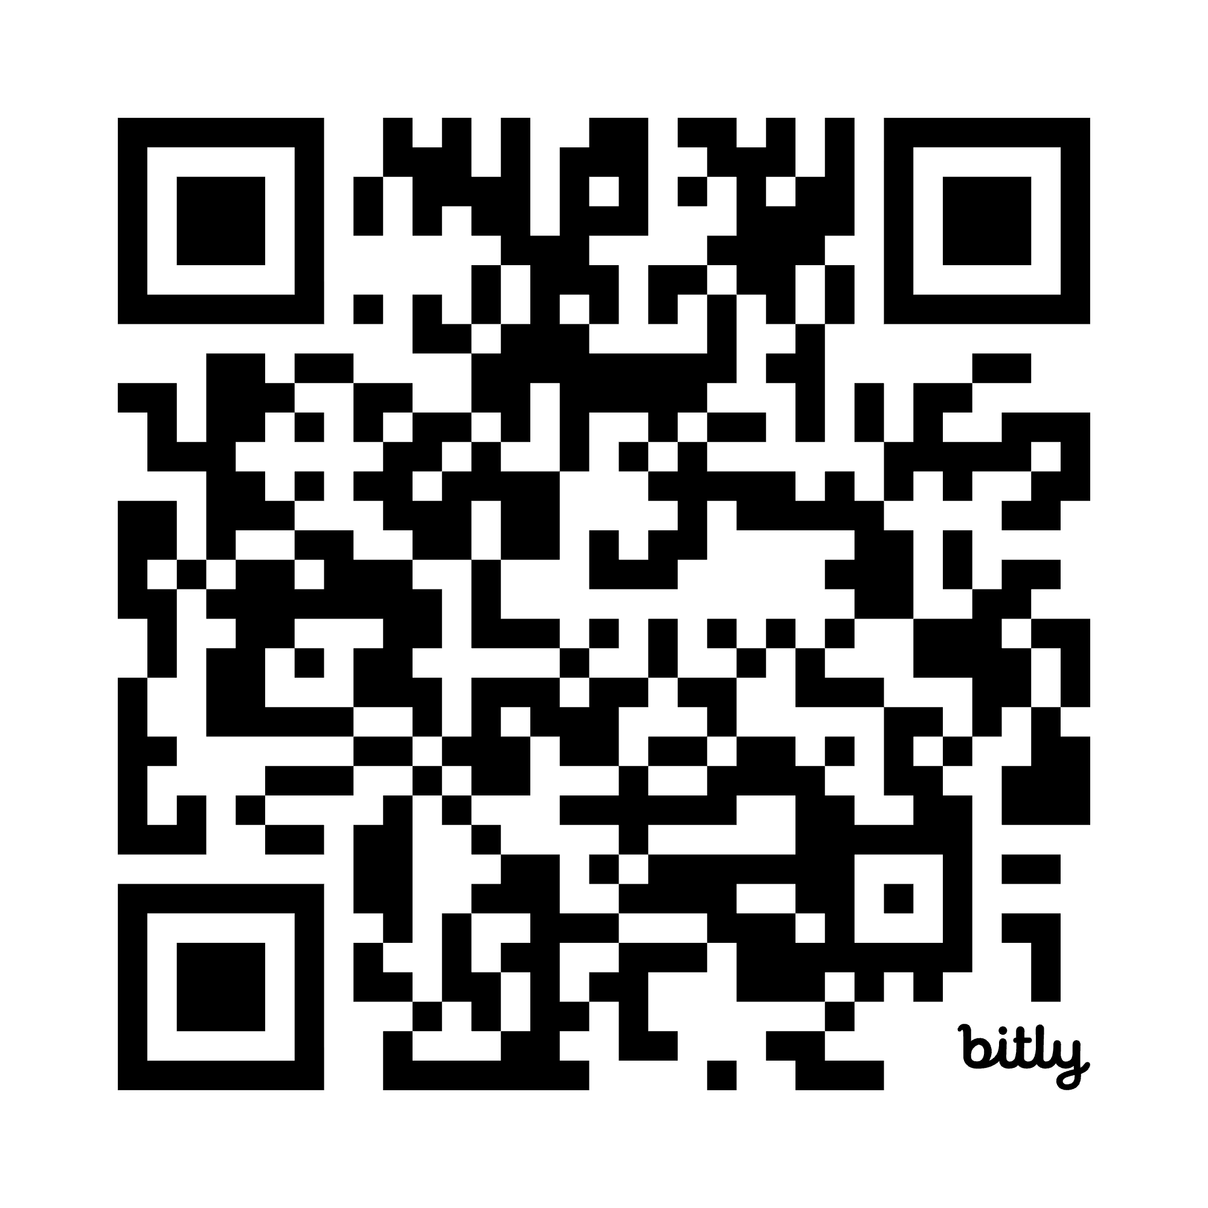


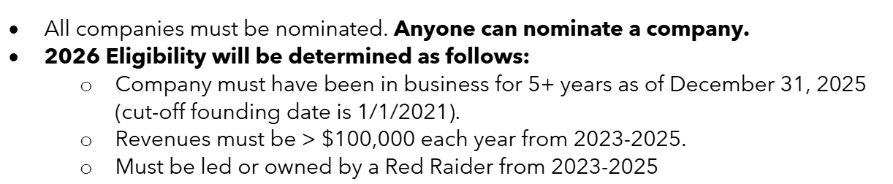
For more info

Slide 11
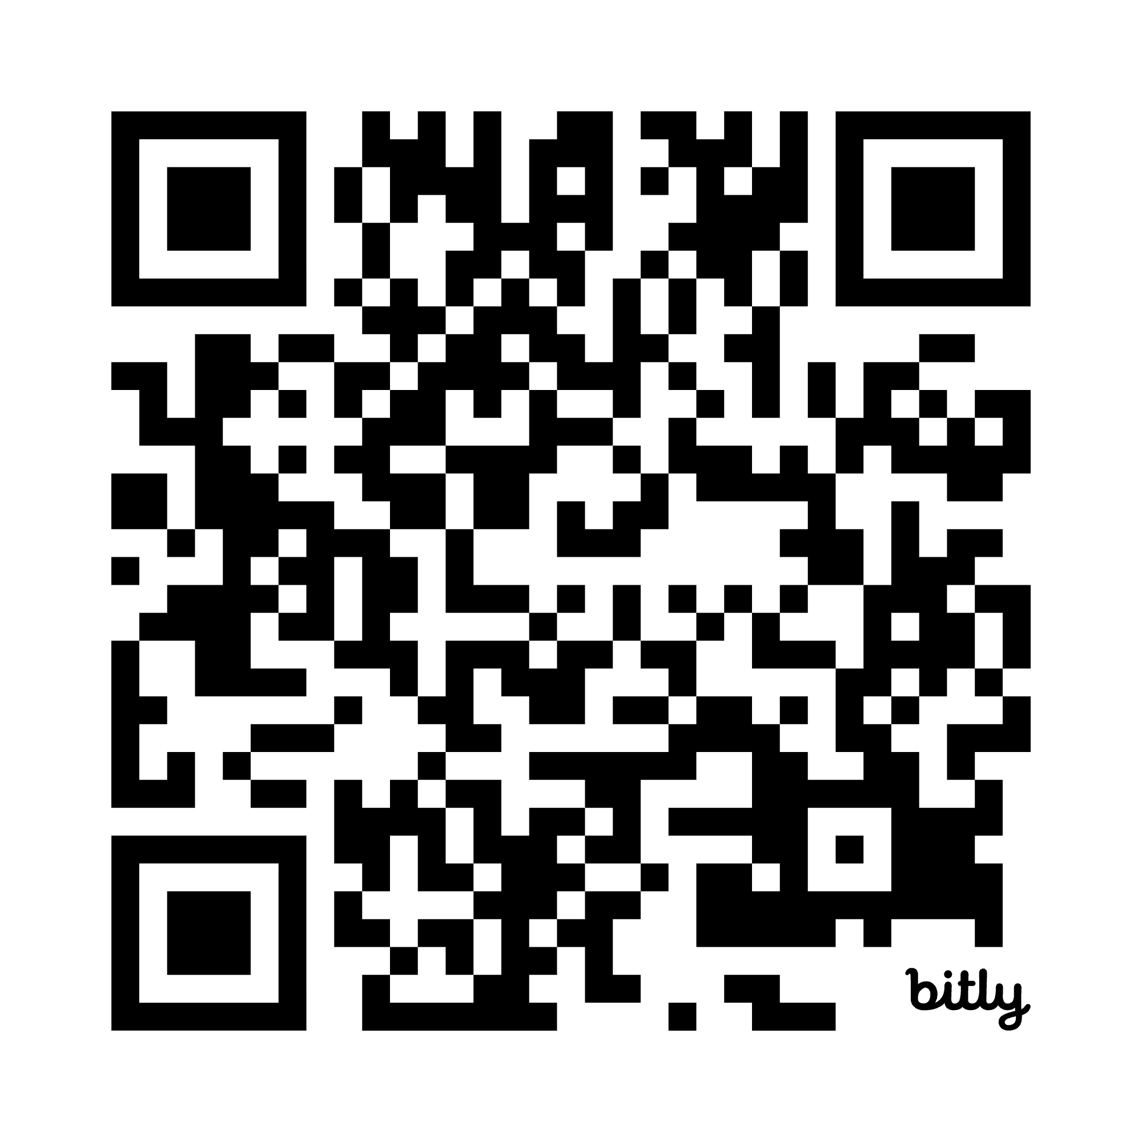
THANK YOU
FOR JOINING US!
SCAN FOR
PRESENTATION

