Slide 1


CURRENT ECONOMIC CONDITIONS & TRENDS
February 26, 2026

Slide 2
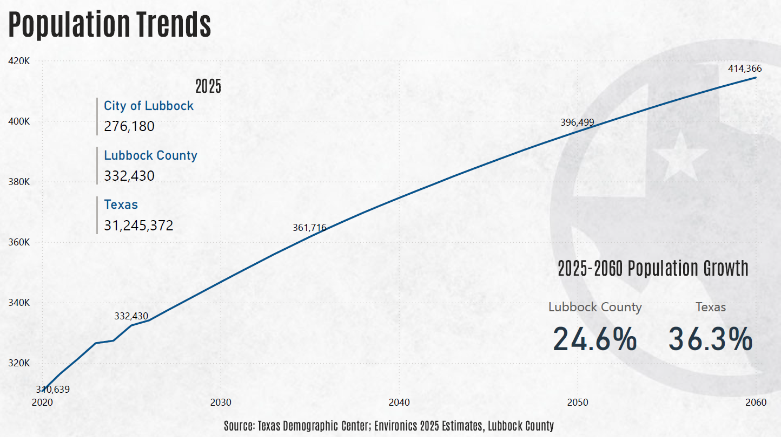

Slide 3
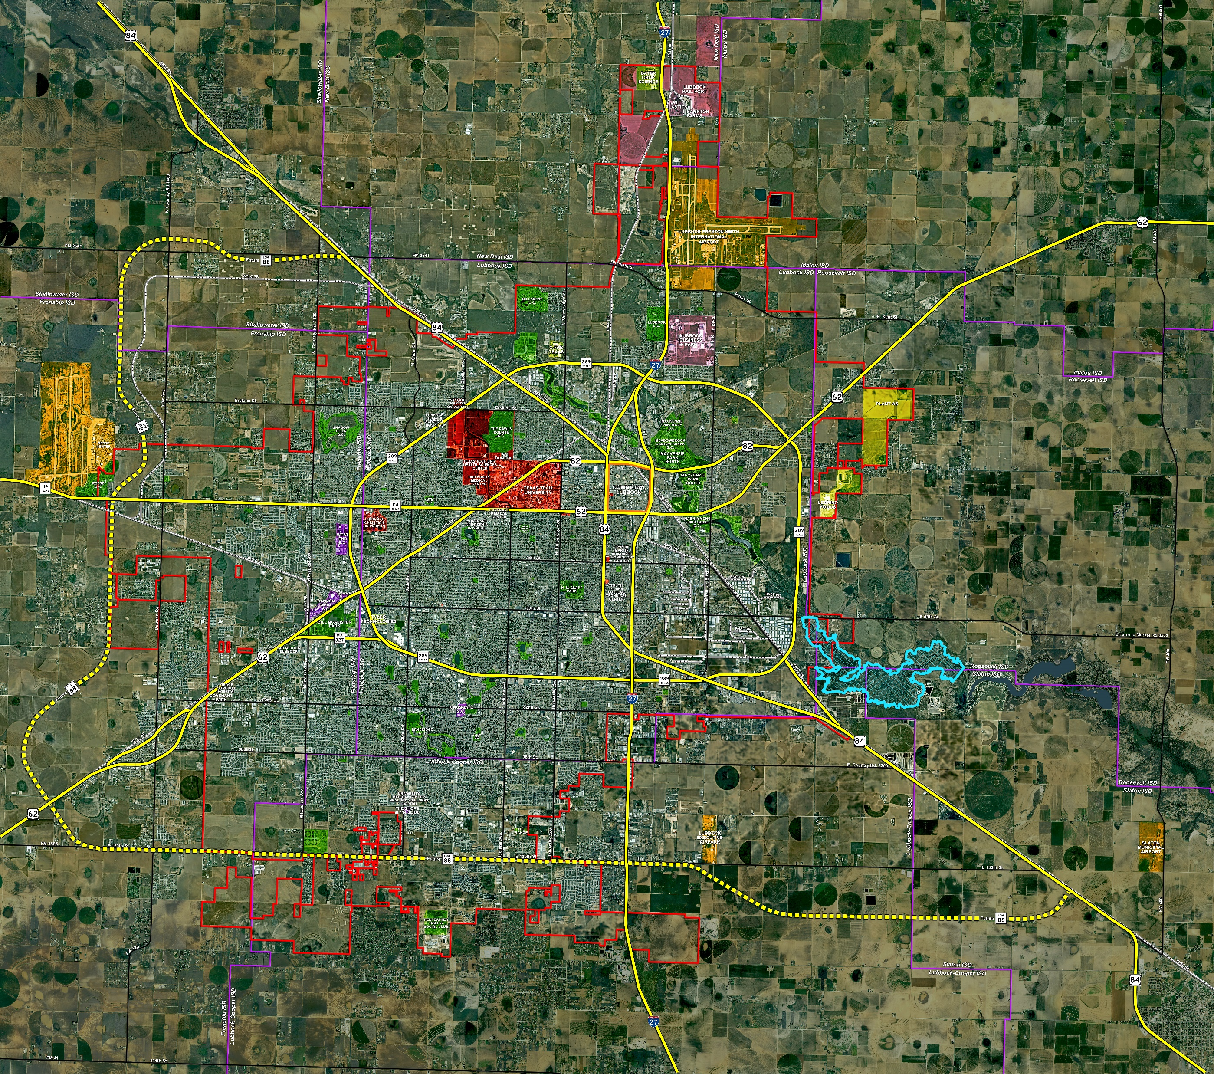

Growing Lubbock
2025
City of Lubbock: 276,180
Lubbock County: 332,430
Texas: 31,245,372
2025-2050
Population Growth
Lubbock Co 19.3%
Texas
28.2%

Slide 4
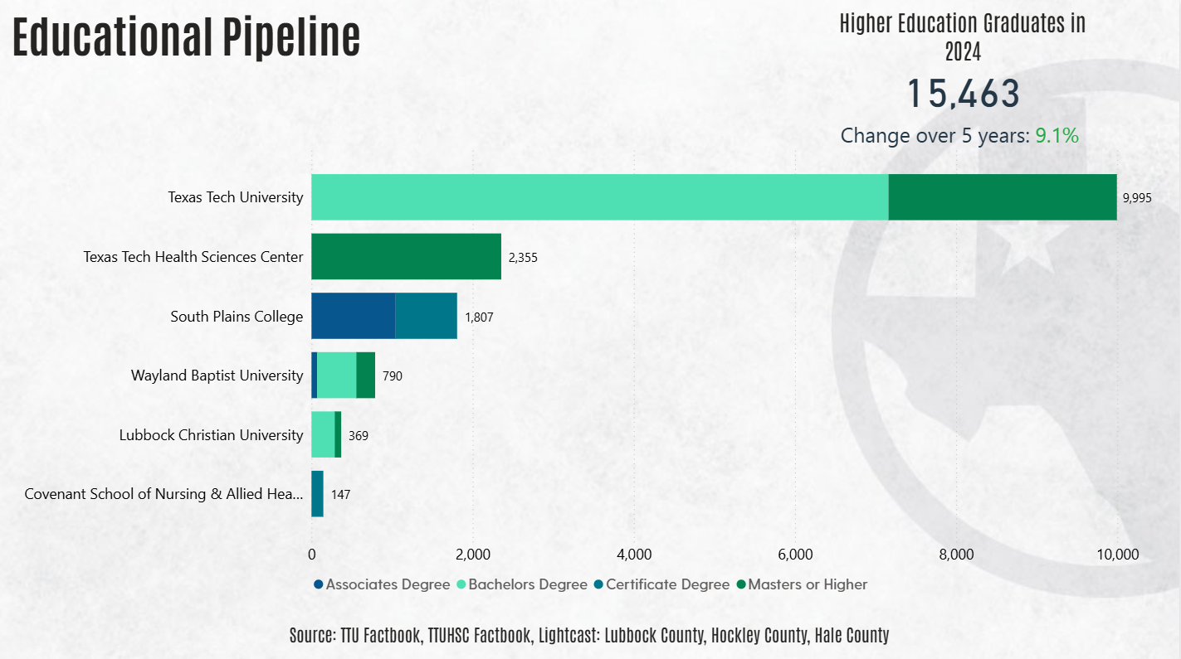

Slide 5
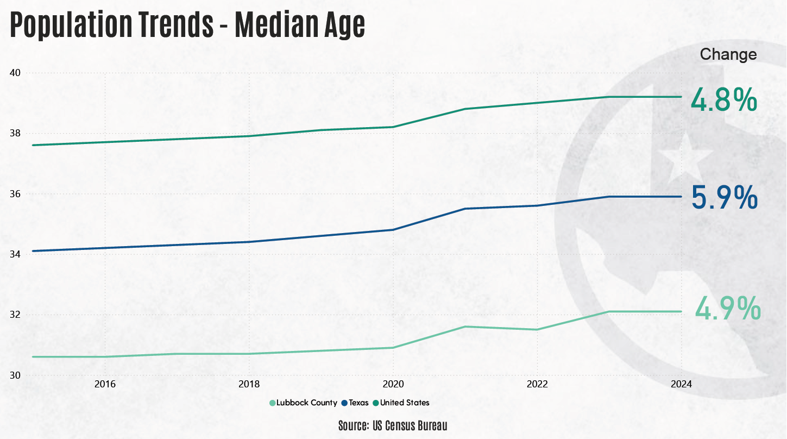
Population Trends
Notes:
textbox
No alt text provided
2025
No alt text provided
lineChart
No alt text provided
textbox
No alt text provided
2025-2060 Population Growth
No alt text provided

Slide 6
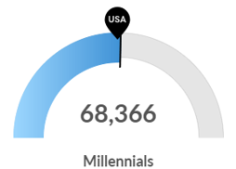
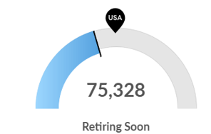
Lubbock County Population Characteristics
# of Millennials Similar to National Average
1.02 : 1.00
Retirement Risk Low
in Lubbock
0.76 : 1.00
Source: Lightcast / Region / Economy Overview - Lubbock County
Notes:
Source: Lightcast/Region/Economy Overview/Lubbock County (Lubbock Total/National Avg.)
12.9.25 AZ: No new data
6.9.25 AZ: No new data
4.14.25 JQ: Data updated. (Lubbock Total / National Avg.)
1.13.25 JO: No changes required
11.10.25 AZ: Updated charts and numbers
Data updated on 10.15.24. JQ

Slide 7
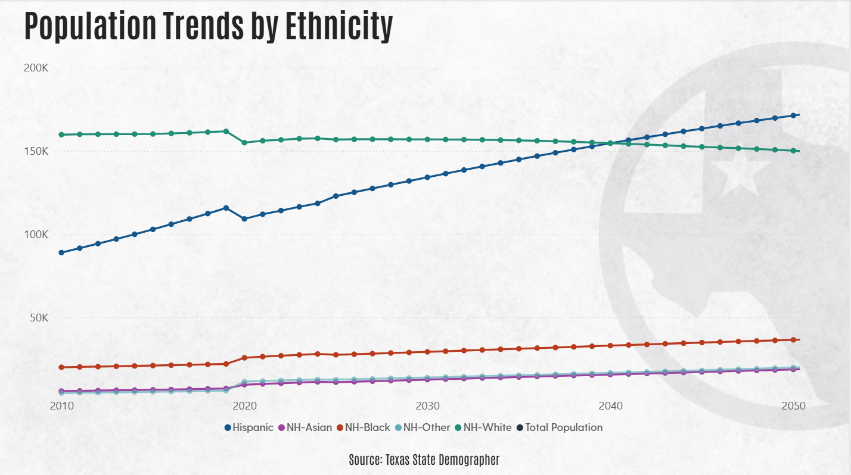
Notes:
Source: Texas State Demographer, Projections, Release Year 2018
6.30.25 AZ: Created

Slide 8
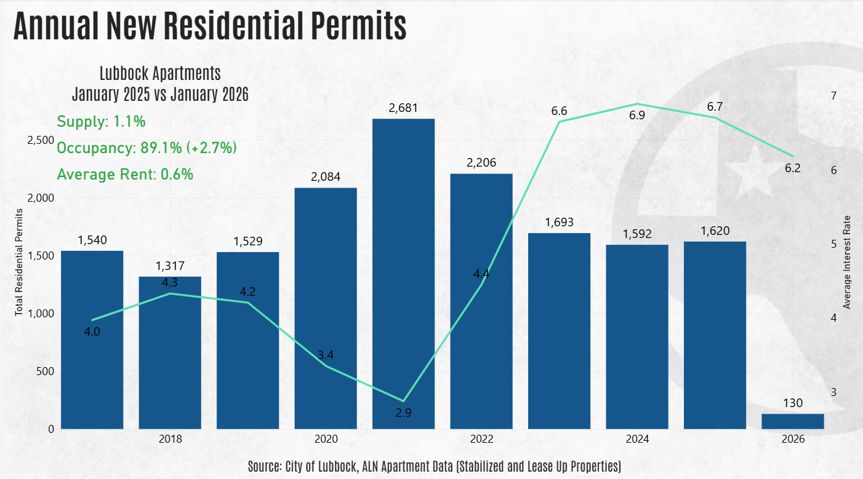

Annual New Residential Permits
2026 YTD through January
Notes:
columnChart
No alt text provided
Lubbock Apartments
August 2024 vs August 2025
No alt text provided
textbox
No alt text provided
textbox
No alt text provided

Slide 9
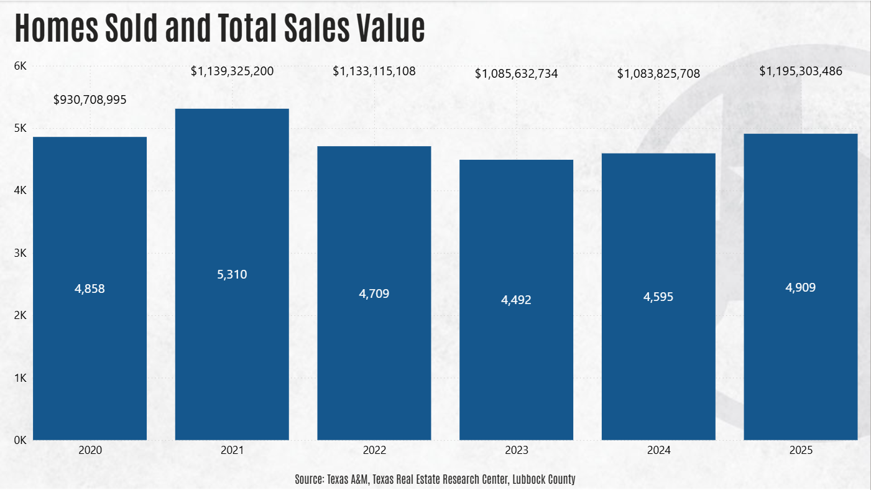
Average Home Sales
2025 YTD through November
Notes:
lineClusteredColumnComboChart
No alt text provided
textbox
No alt text provided
textbox
No alt text provided

Slide 10
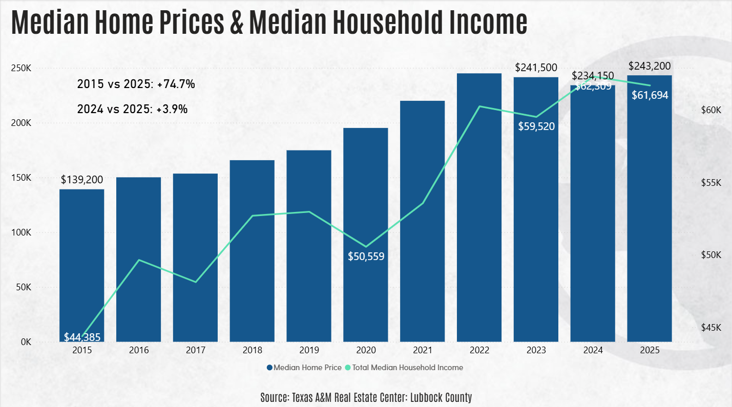
Median Home Price
YTD through November
Notes:
lineClusteredColumnComboChart
No alt text provided
textbox
No alt text provided
cardVisual
No alt text provided
textbox
No alt text provided

Slide 11
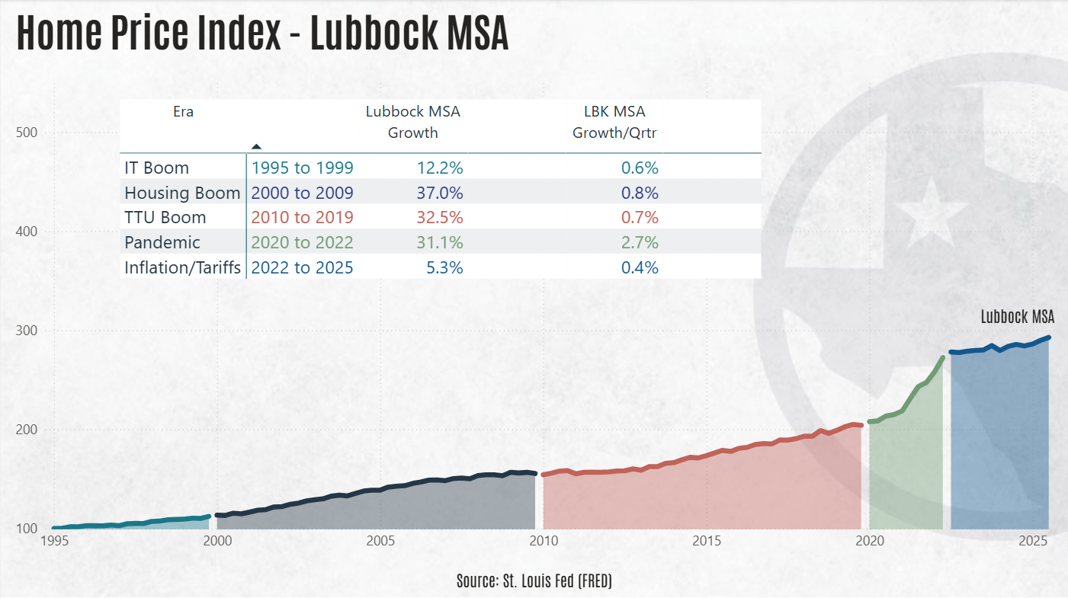

Slide 12
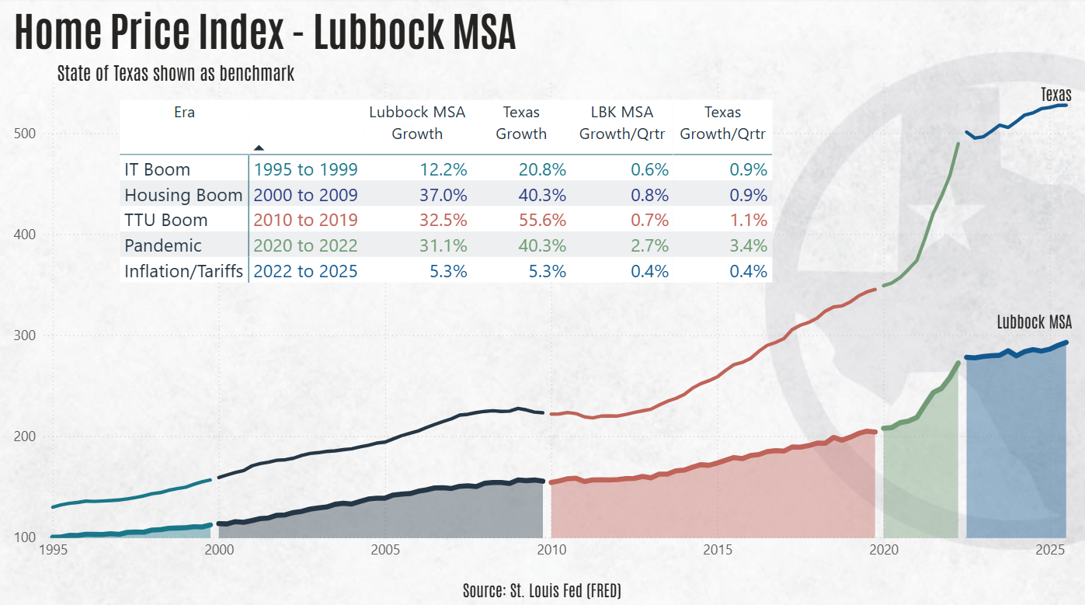

Slide 13
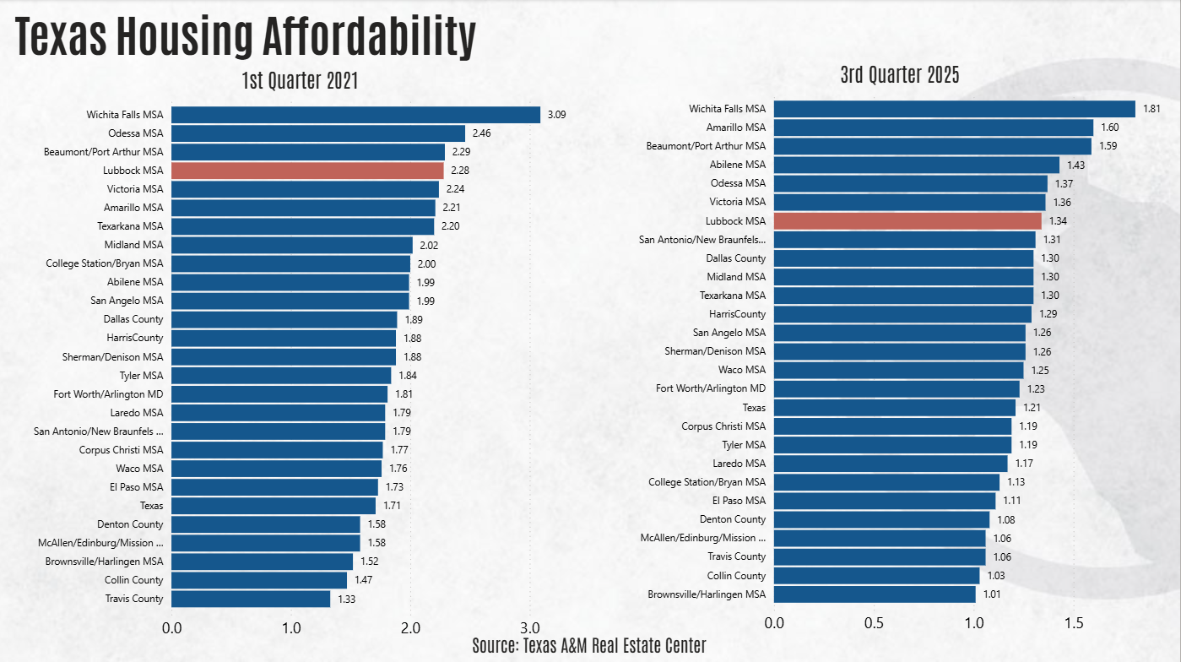
Texas Housing Affordability
Notes:
1st Quarter 2021
No alt text provided
2nd Quarter 2025
No alt text provided
textbox
No alt text provided
textbox
No alt text provided

Slide 14
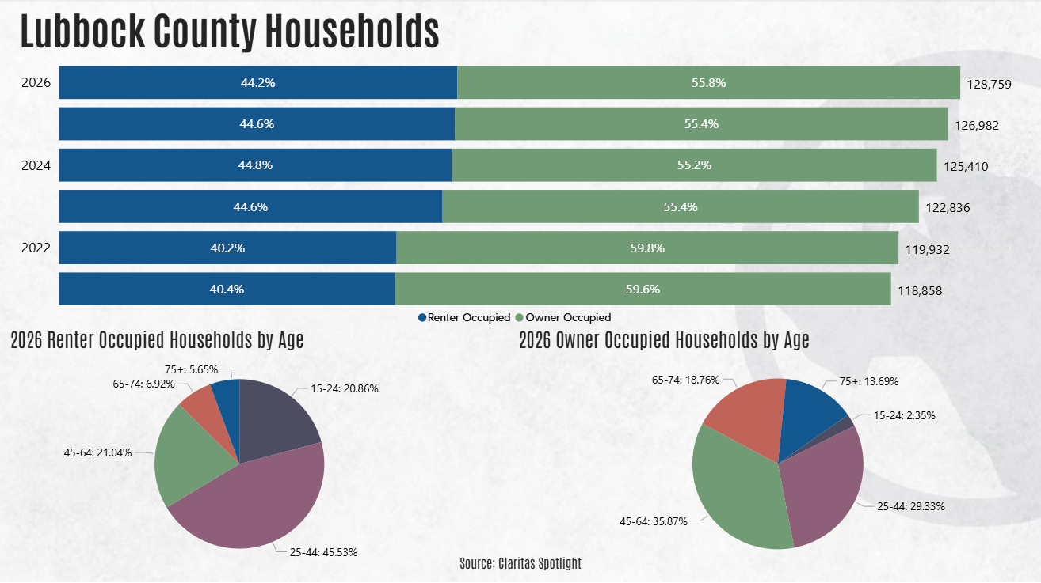

Slide 15
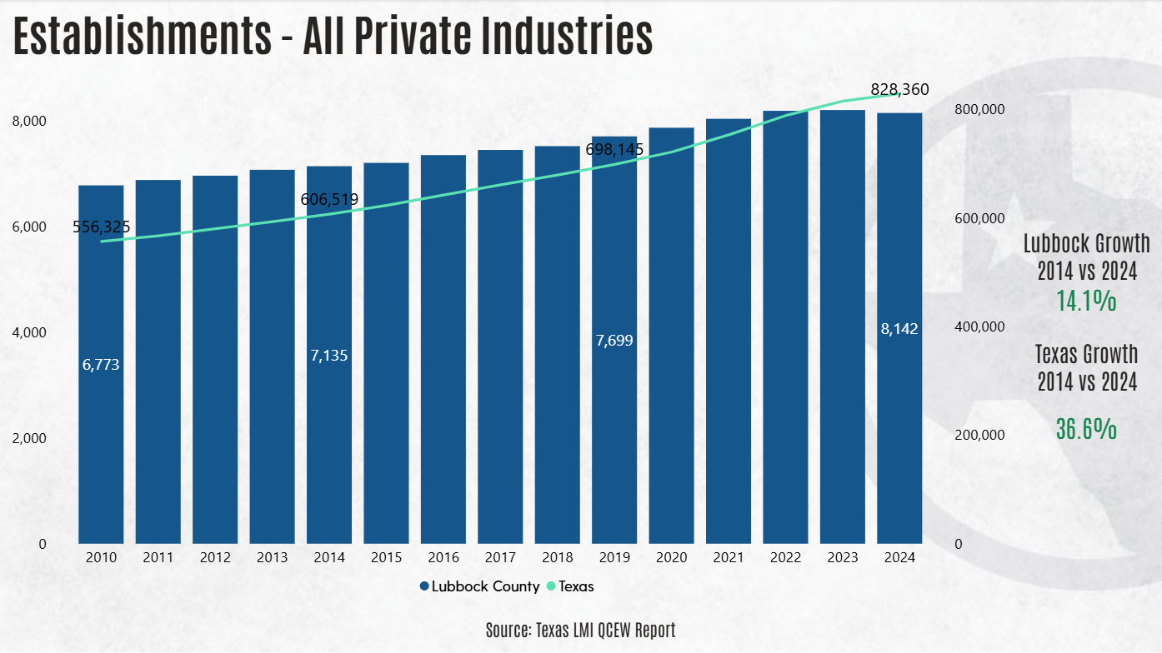
Establishments - All Private Industries
Notes:
textbox
No alt text provided
lineStackedColumnComboChart
No alt text provided
Lubbock Growth 2014 vs 2024
No alt text provided
Texas Growth 2014 vs 2024
No alt text provided
textbox
No alt text provided

Slide 16
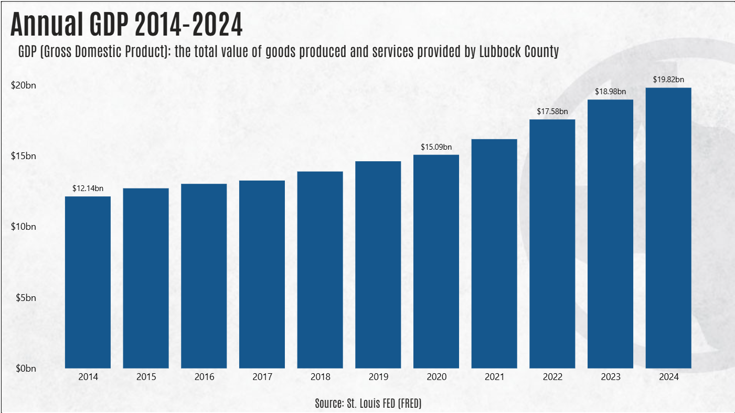
Annual GDP
Notes:
lineClusteredColumnComboChart
No alt text provided
Lubbock MSA
2014 vs 2024
No alt text provided
Texas
2014 vs 2024
No alt text provided
textbox
No alt text provided
textbox
No alt text provided

Slide 17
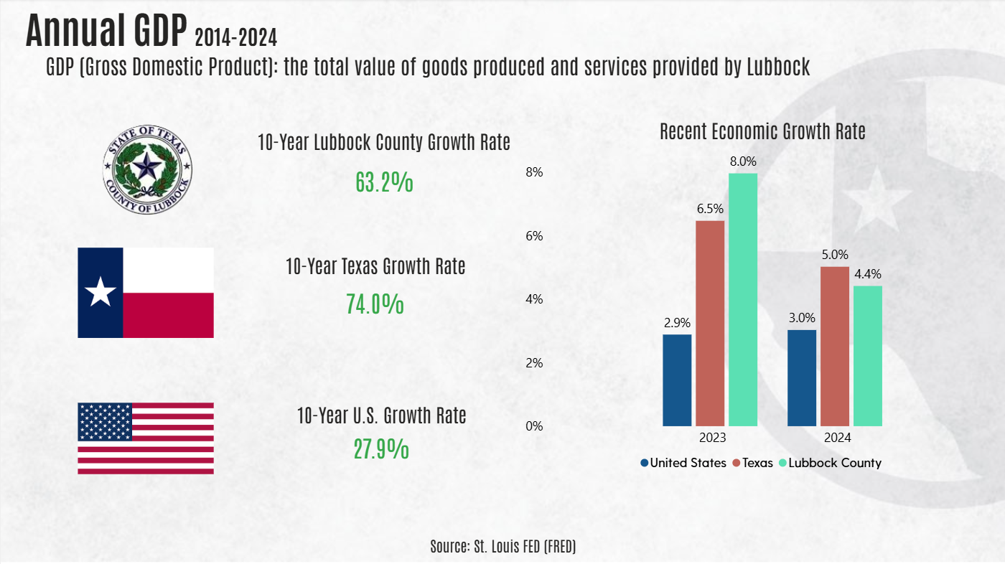
Notes:
Source: FRED Economic Data
6.30.25 AZ: Created.

Slide 18
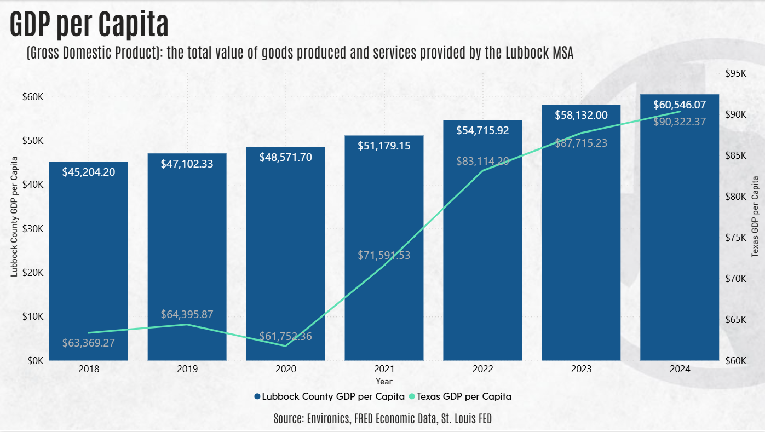
GDP per Capita
Notes:
lineStackedColumnComboChart
No alt text provided
textbox
No alt text provided
textbox
No alt text provided

Slide 19
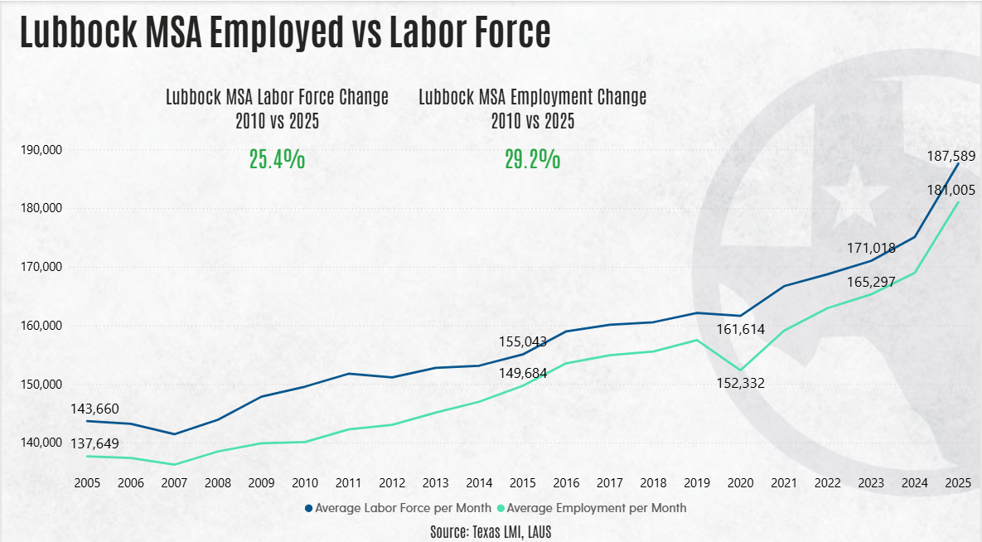
Employed Labor Force
Notes:
lineChart
No alt text provided
Lubbock MSA Labor Force Change
2005 vs 2025
No alt text provided
Lubbock MSA Employment Change
2005 vs 2025
No alt text provided
textbox
No alt text provided
textbox
No alt text provided

Slide 20
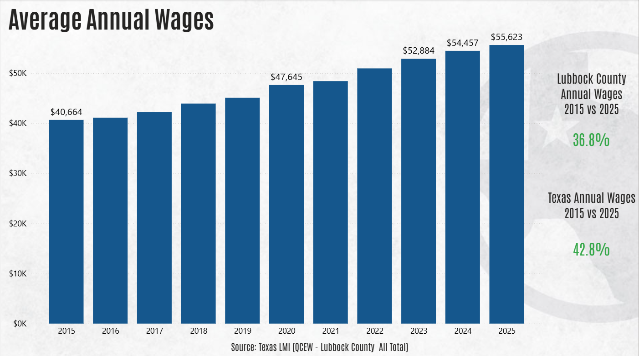
Average Annual Wages
YTD through Q2
Notes:
clusteredColumnChart
No alt text provided
Lubbock County Annual Wages
2014 vs 2024
No alt text provided
Texas Annual Wages
2014 vs 2024
No alt text provided
textbox
No alt text provided
textbox
No alt text provided

Slide 21
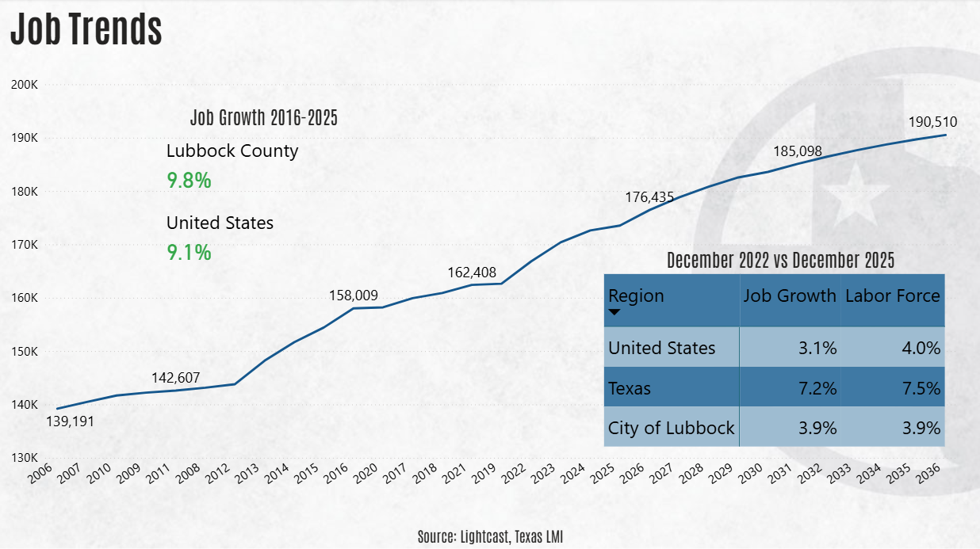
Job Trends
Notes:
lineChart
No alt text provided
textbox
No alt text provided
textbox
No alt text provided
Job Growth 2016-2025
No alt text provided
2025 - 2035
Lubbock County New Jobs
No alt text provided

Slide 22
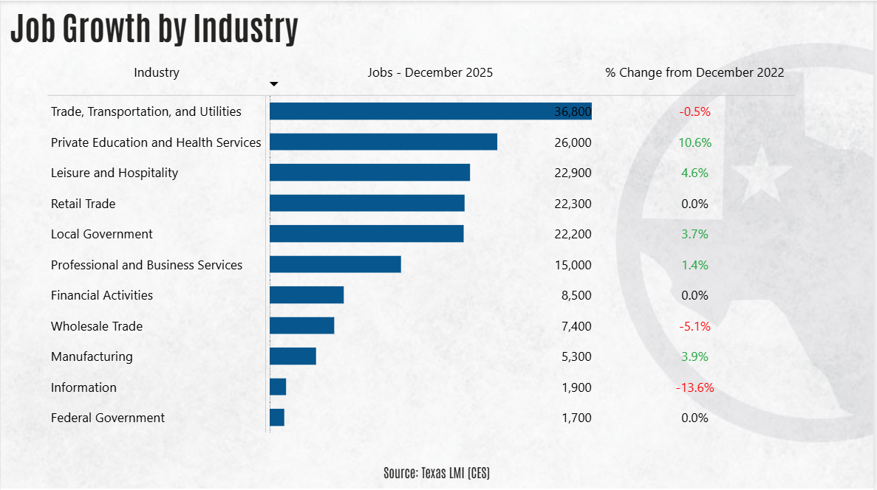

Slide 23
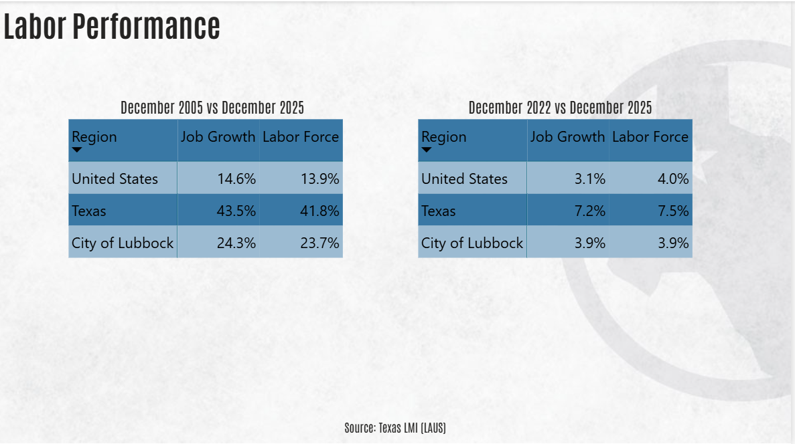
Labor Performance
Notes:
August 2005 vs August 2025
No alt text provided
August 2020 vs August 2025
No alt text provided
textbox
No alt text provided
textbox
No alt text provided

Slide 24
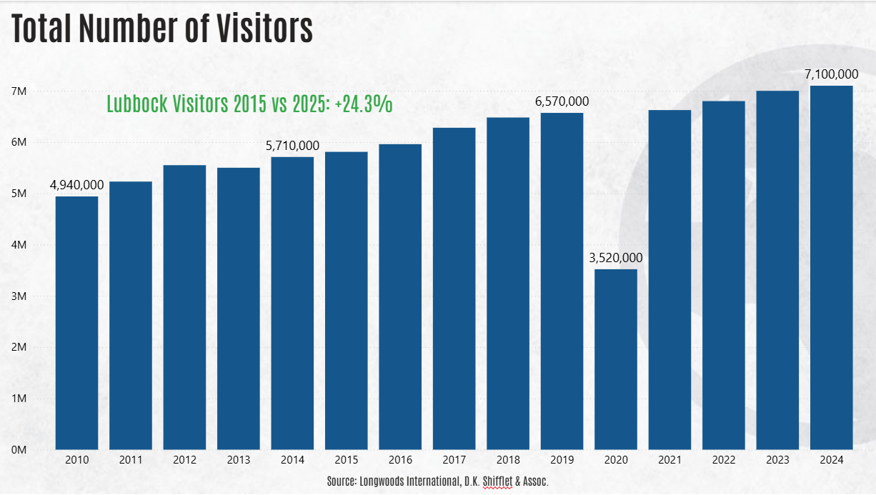
Visitors
Notes:
columnChart
No alt text provided
Lubbock Visitors 2014 vs 2024: +24.3%
No alt text provided
card
No alt text provided
textbox
No alt text provided

Slide 25
Visitor Impact
The impact of local sales tax dollars generated by visitors to is enough to fund:
109.1%
OF CULTURAL & RECREATION SERVICES
Without tourism, each household in Lubbock would need to spend an additional
$9,246.26 ANNUALLY
in local establishments
Source: Dean Runyan Associates, City of Lubbock
Notes:
6.9.25 AZ: No new data.
4/14/25 JQ: ????
1.13.25 JO: No changes required
11.4.24 – Add 1/5 (or whatever the number is) of the City’s budget is attributed to taxes from visitor spending, less HOT
11.4.24 – Took the data from slide 46 and added formatting to it. Let me know if you don’t like it and I will change it up.

Slide 26
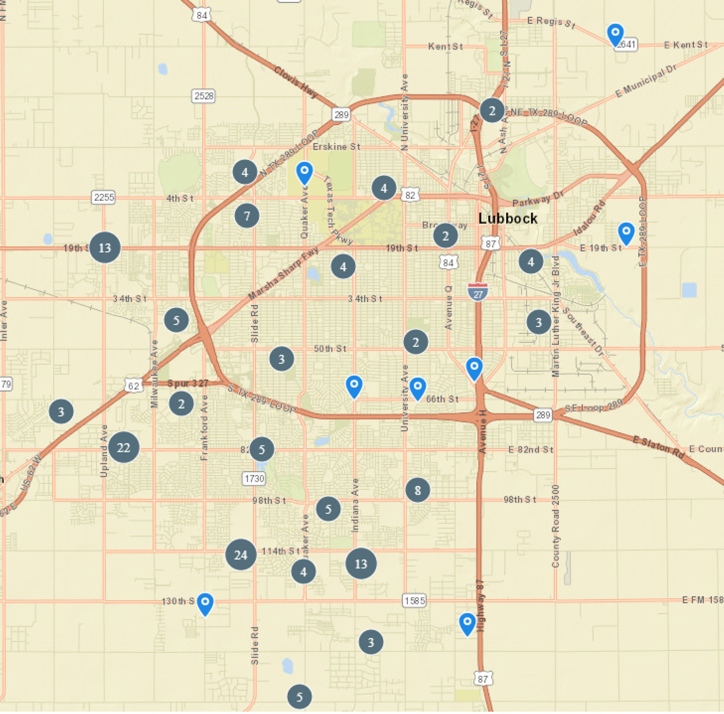
FY 2023-24 Commercial Permits
Source: City of Lubbock
Notes:
6.30.25 AZ: No new data.
6.9.25 AZ: No new data.
4.14.25 JQ: I’m struggling to recall where at the City we got this. ????
1.13.25 JO: No changes required
Data updated on 10.17.24 JQ

Slide 27
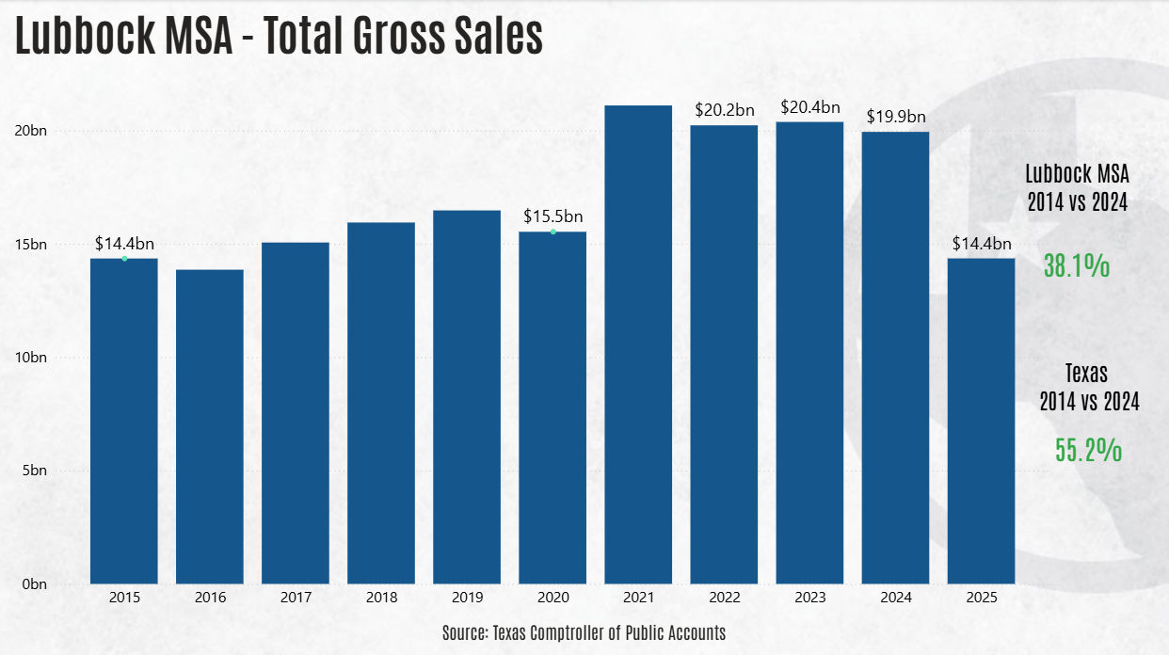
Annual Gross Sales
2025 YTD through 3rd Quarter
Notes:
lineClusteredColumnComboChart
No alt text provided
Lubbock MSA
2014 vs 2024
No alt text provided
Texas
2014 vs 2024
No alt text provided
textbox
No alt text provided
textbox
No alt text provided

Slide 28
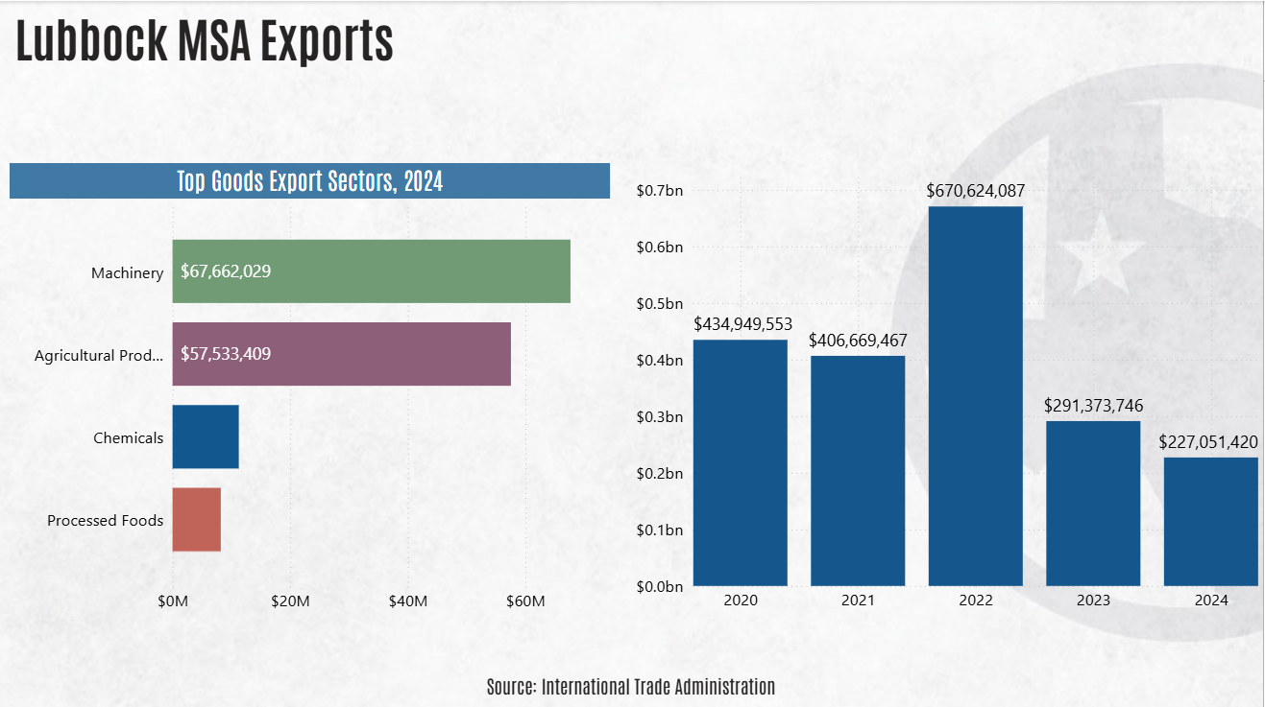
Lubbock MSA Exports
Notes:
textbox
No alt text provided
Top Goods Export Sectors, 2023
No alt text provided
clusteredColumnChart
No alt text provided
textbox
No alt text provided

Slide 29
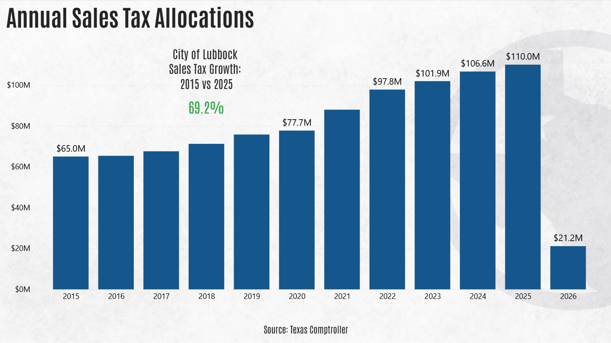
Sales Tax Allocations
YTD through February
Notes:
textbox
No alt text provided
columnChart
No alt text provided
City of Lubbock
Sales Tax Growth:
2014 vs 2024
No alt text provided
textbox
No alt text provided

Slide 30
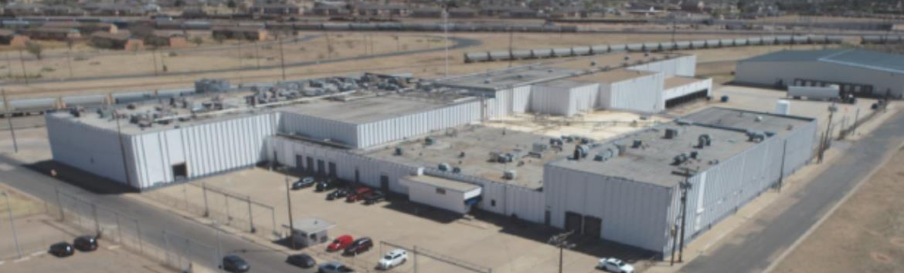
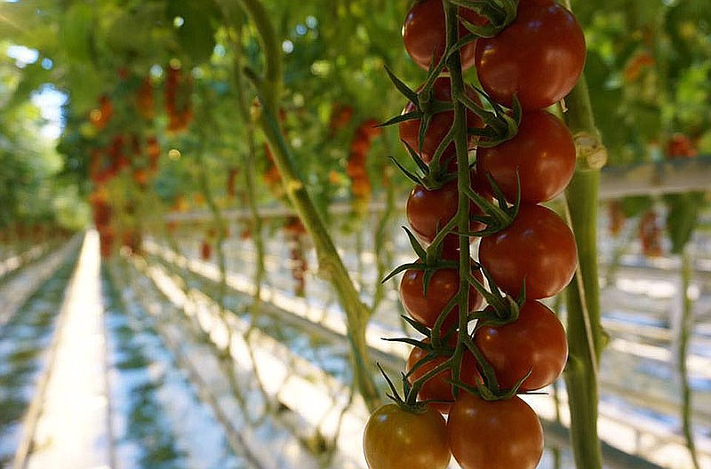

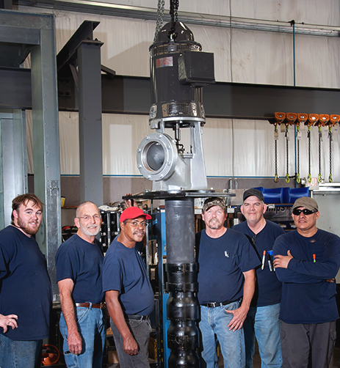
Recent Announcements
Plant Ag Systems
Hydroponics with data
$674 Million investment
936 jobs
Construction begins 2026
Tropicale
Frozen Novelties Mfg
$66.8 Million investment
500 jobs
Production began 2023
Vulpes Corporation
Chemical Mfg
$9.9 Million investment
62 jobs
Plant opened late 2024
HydroFlow
Pump Mfg
$1.88 Million investment
38 jobs
Plant expansion
Notes:
4/14/25 JQ: ????
Updated 1.13.25 JQ
Updated 3.19.24 JQ

Slide 31
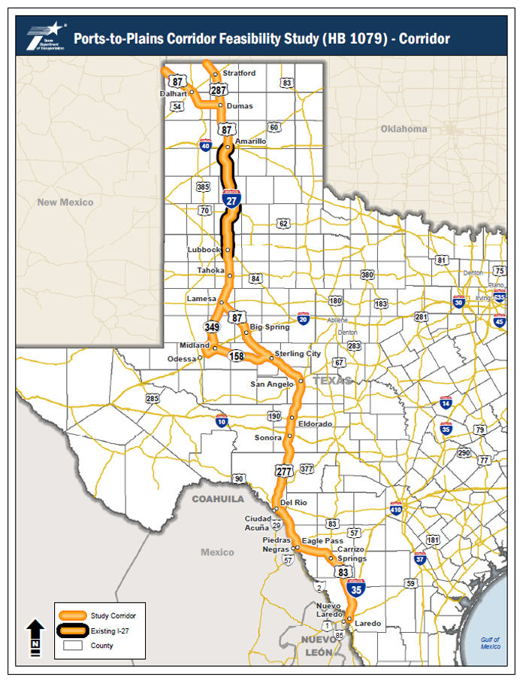
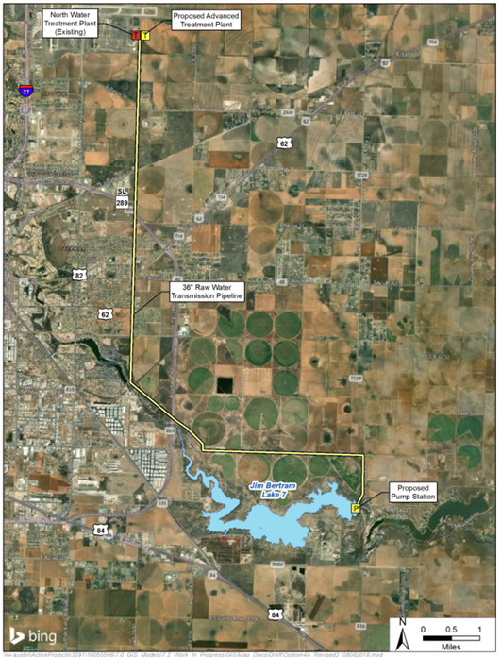
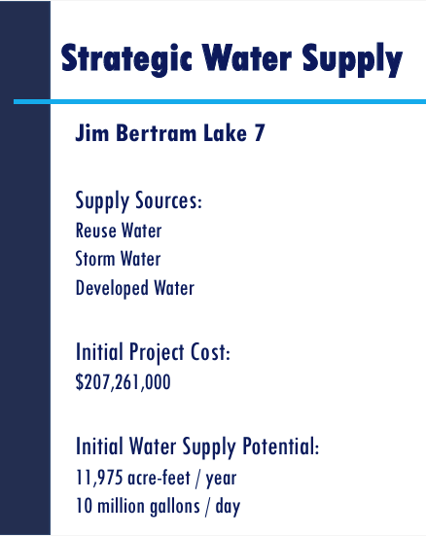


Long-Term Lubbock Growth
Transportation
Water
I27 expansion now designated
Future Water Supply – Lake 7 ready in 2032
56% of Exports
12
54% of Exports
LAH: 20M gal/day
Notes:
4/14/25 JQ: ????
1.13.25 JO: No changes required
JO: Edits to this slide are complete. 11.1.23
10.31.23 – Updated from trade.gov

Slide 32

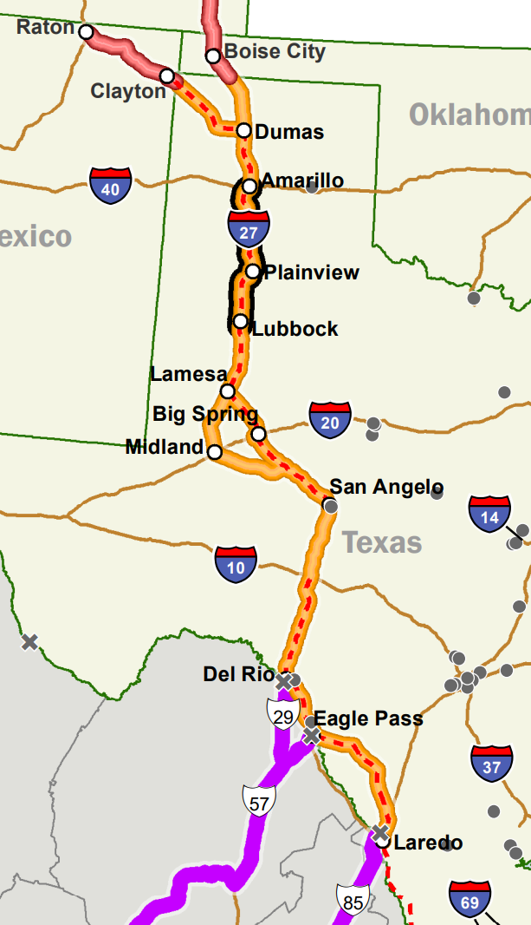
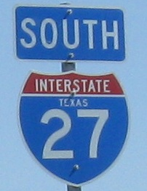
I27 & Hwy Growth

Slide 33
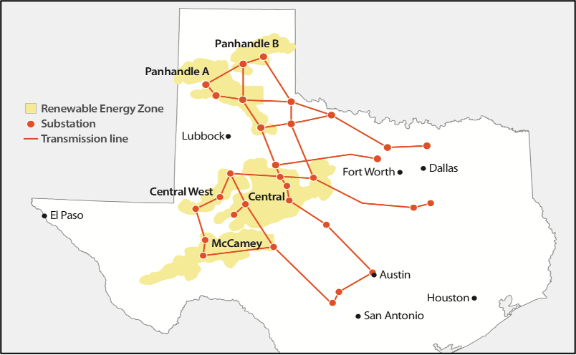
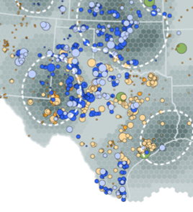
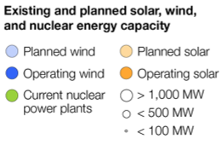
Long-Term Lubbock Growth
Electricity
2023: LP&L Joined ERCOT
2024: LP&L Territory in
Competitive Environment
Growth of Renewables
56% of Exports
54% of Exports
Notes:
4/14/25 JQ: ????
1.13.25 JO: No changes required
JO: Edits to this slide are complete. 11.1.23
10.31.23 – Updated from trade.gov

Slide 34

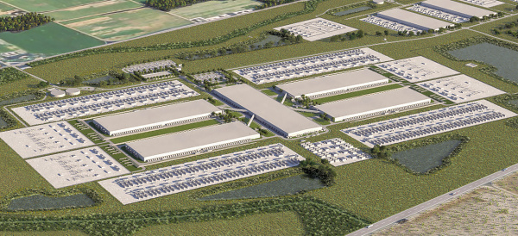
Providing Power
56% of Exports

Slide 35
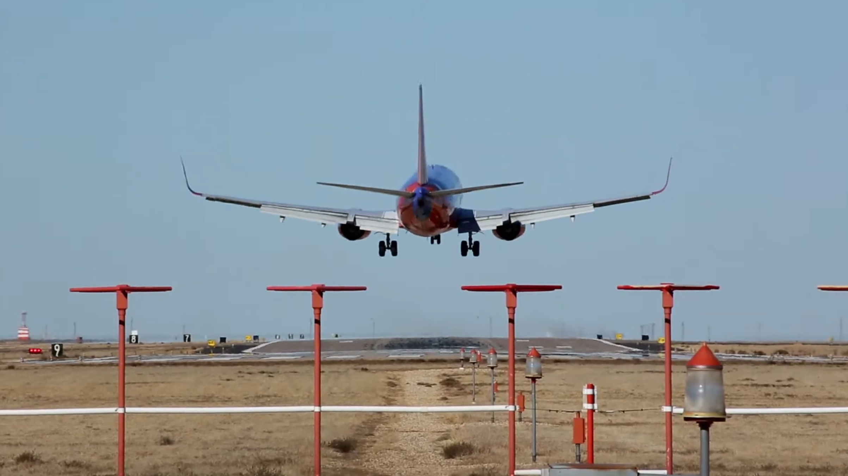

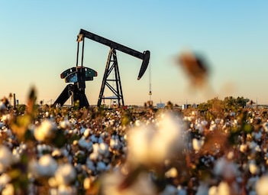
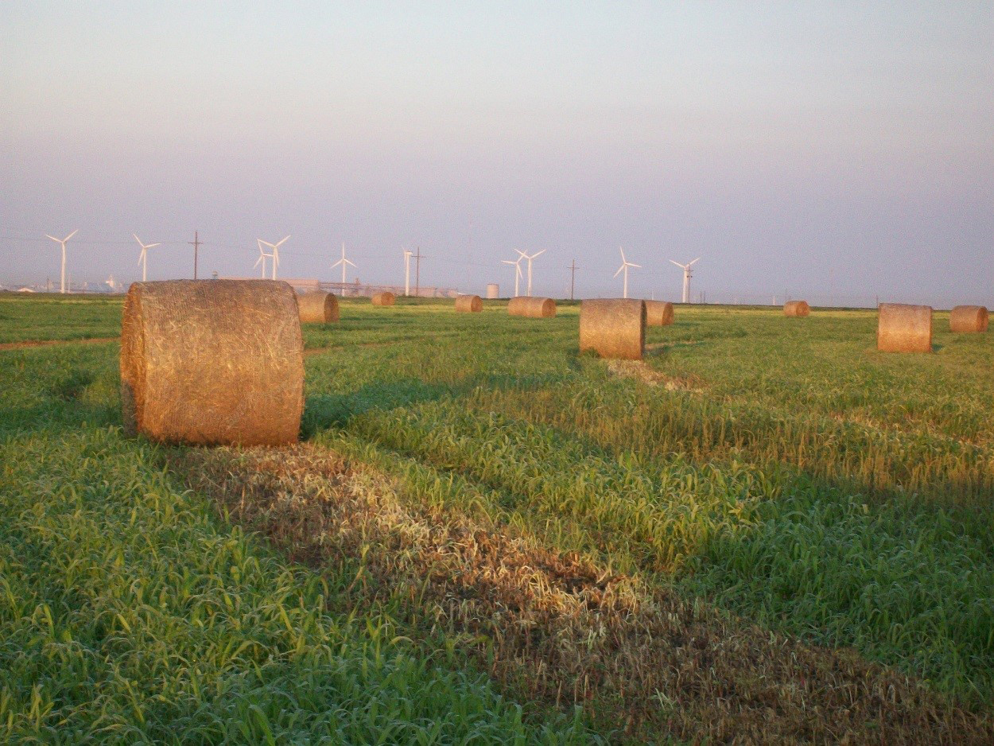

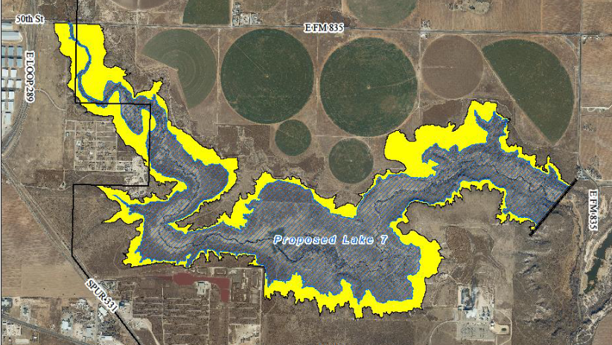
Development Awareness

Slide 36
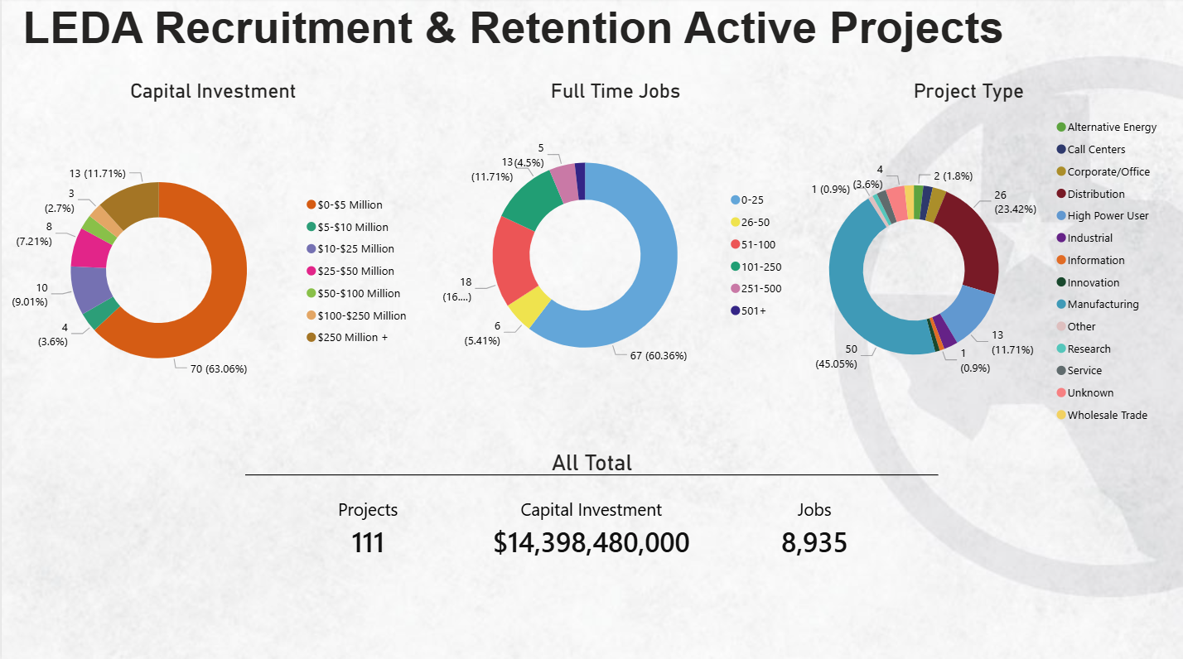
Notes:
Source: "C:\Users\amy.zientek\Lubbock Economic Development Alliance\CVB - Documents\CVB\convention.bureau\Amy Z\Research\Power BI\Economic Conditions & Trends Future Opportunities Slides.pbix"

Slide 37
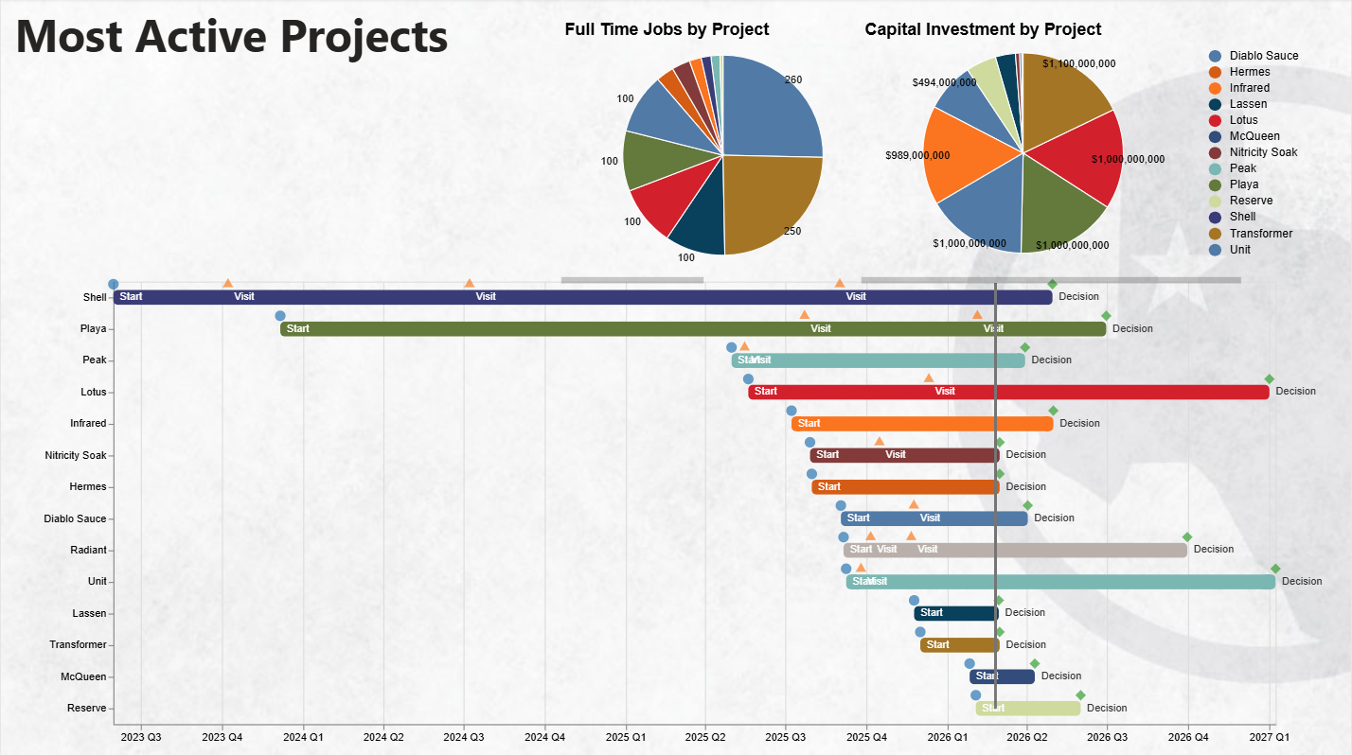
Notes:
Source: "C:\Users\amy.zientek\Lubbock Economic Development Alliance\CVB - Documents\CVB\convention.bureau\Amy Z\Research\Power BI\LEDA Timelines.pbix"

Slide 38





Notes:
4/14/25 JQ: ????
1.13.25 JO: No changes required

Slide 39


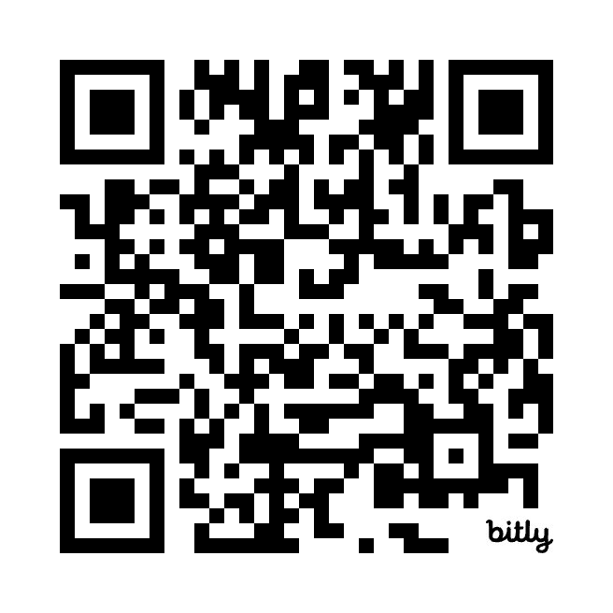



THANK YOU
Notes:
1.13.25 Need new QR code?

